Slide 1
Amortized Variational Inference
using Gaussian Mixture of Experts
Final Presentation by Luyao Deng
Supervisor: Denis Blessing, Philipp Dahlinger, Hongyi Zhou

Slide 2
Motivation
Approximate posterior :
MCMC (cost of computation, large variance)
VI(fast and scalable, small variance)
Traditional VI:
Model selection: simple variational distribution->MoE
Optimization: per context optimization->AVI
2
12/1/2024

Slide 4
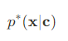
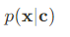
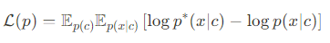
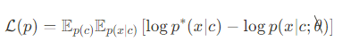
Algorithms
Given: GMM model target
Algorithm 1: direct optimize the ELBO
Algorithm 2: decompose the ELBO and optimize it per component
Algorithm 3: optimize only path derivative part of the ELBO
4
12/1/2024

Slide 5
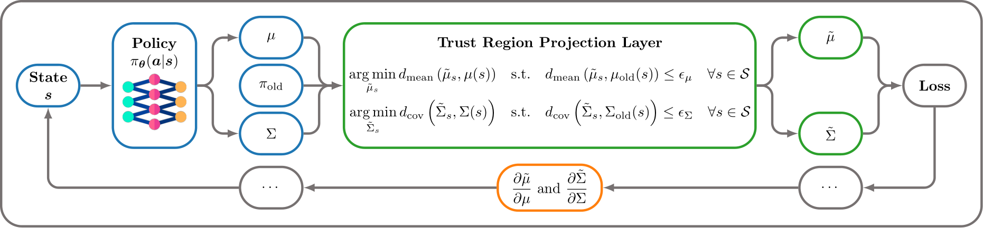
Trust Region Projection Layer
fully differentiable
keeps the new distribution close to the old distribution
ensures careful exploration of the search space
5
12/1/2024

Slide 6
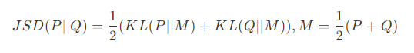
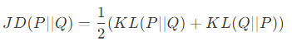
Toy Task
Algorithm
algo_basic: optimize the ELBO with decomposition
algo_kl: optimize the ELBO with decomposition and KL projection
Metric
Jensen Shannon Divergence
Jefferys Divergence
6
12/1/2024

Slide 7
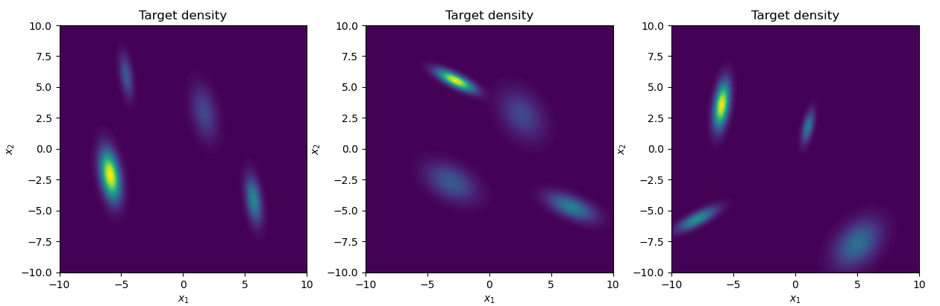
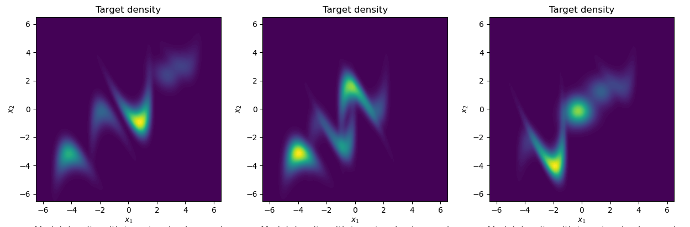
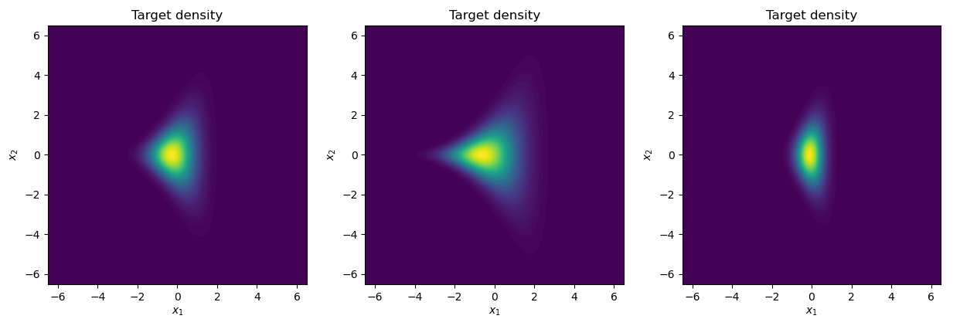
Toy Task
Targets
contextual Gaussian Mixture Target
contextual Banana Mixture Target
contextual 10D Funnel Target
7
12/1/2024

Slide 8
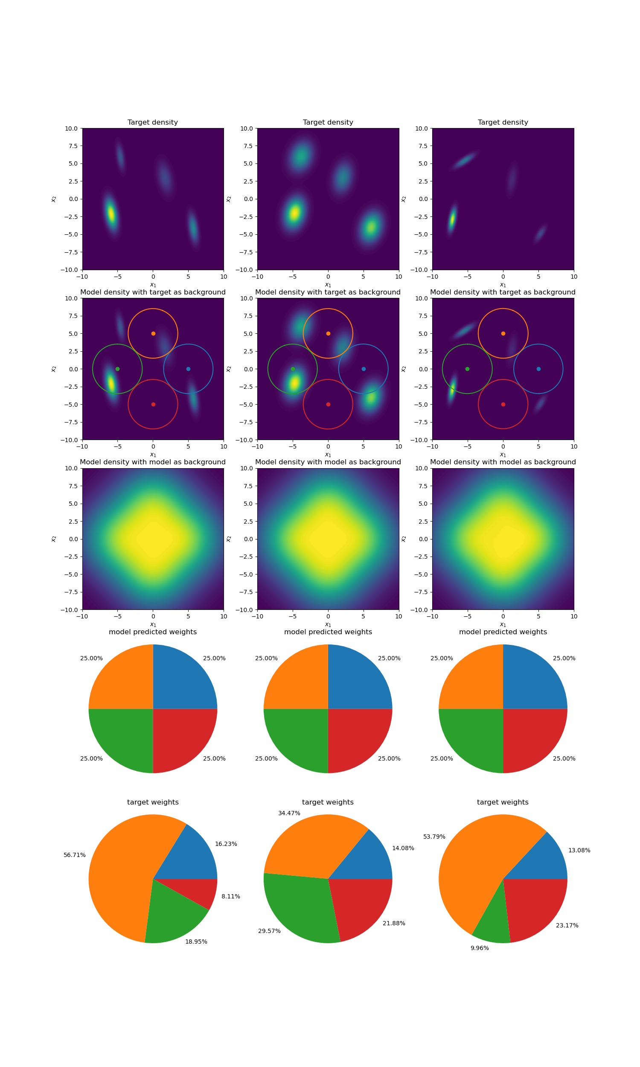
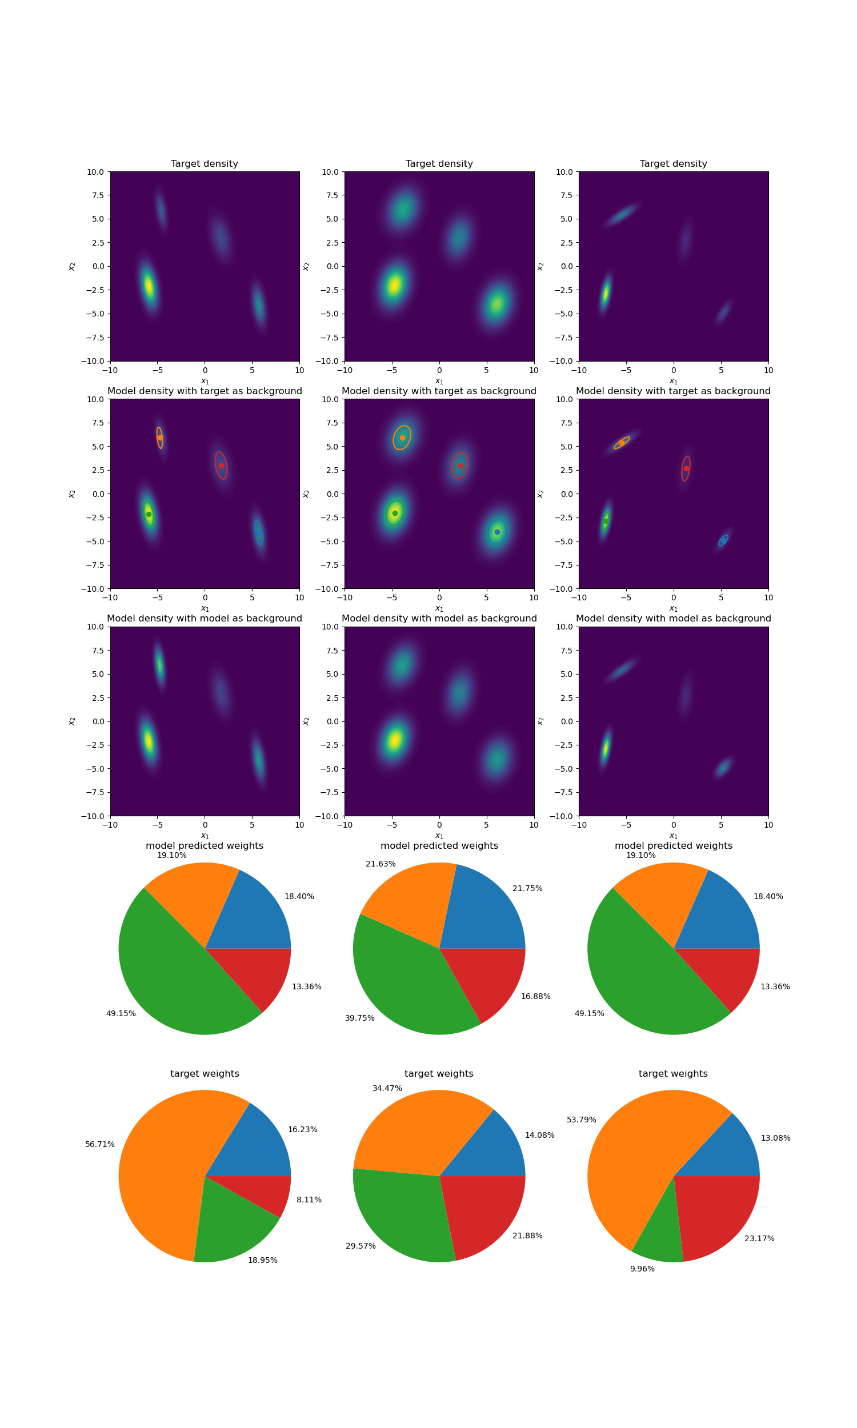
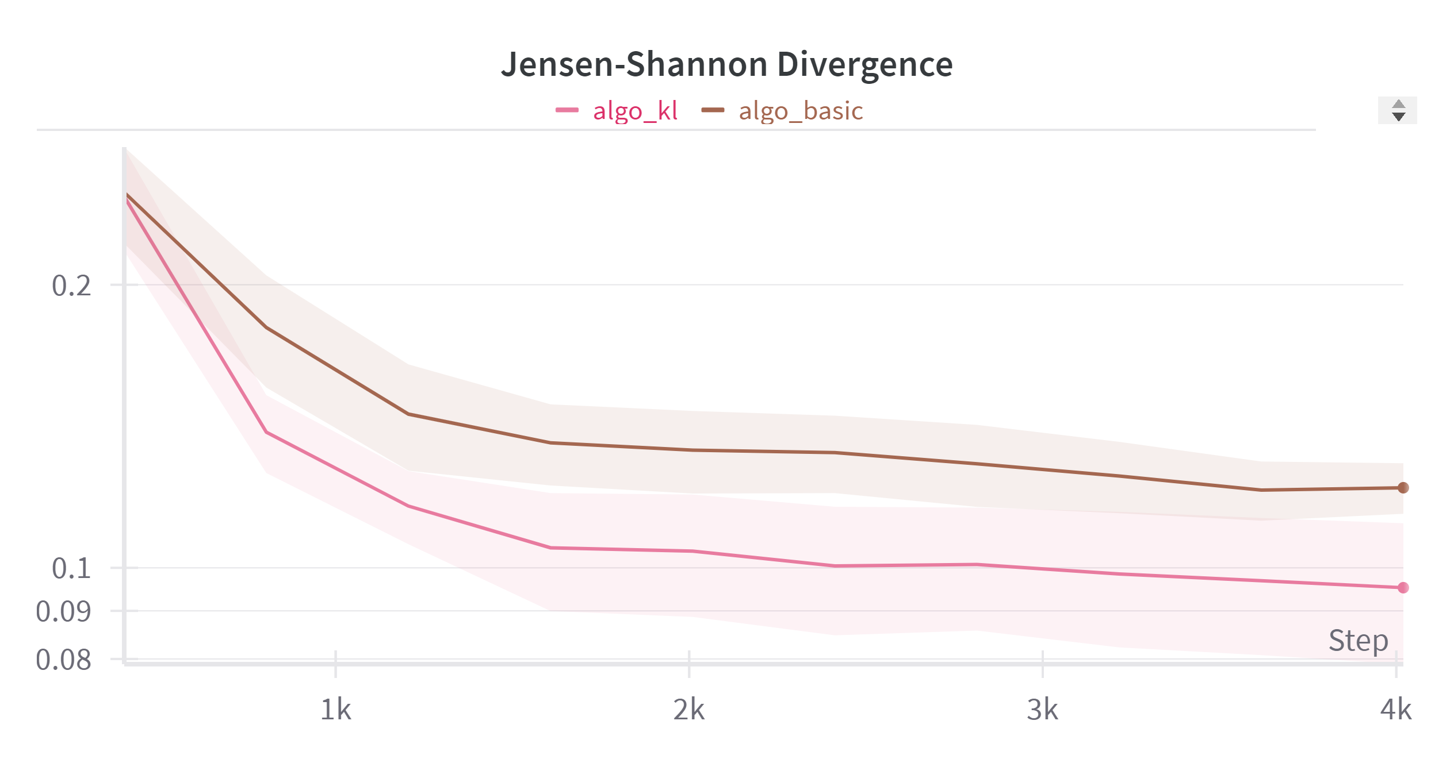
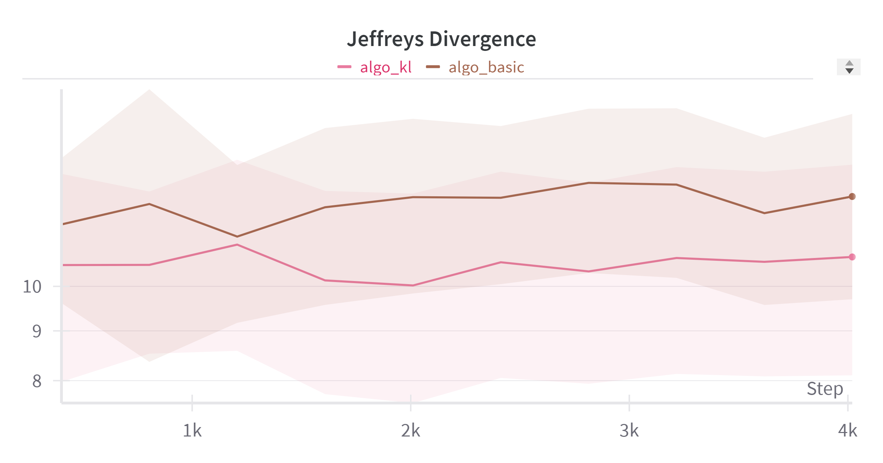
Toy Task-GMM
initial model distribution
learned model distribution
8
12/1/2024

Slide 9
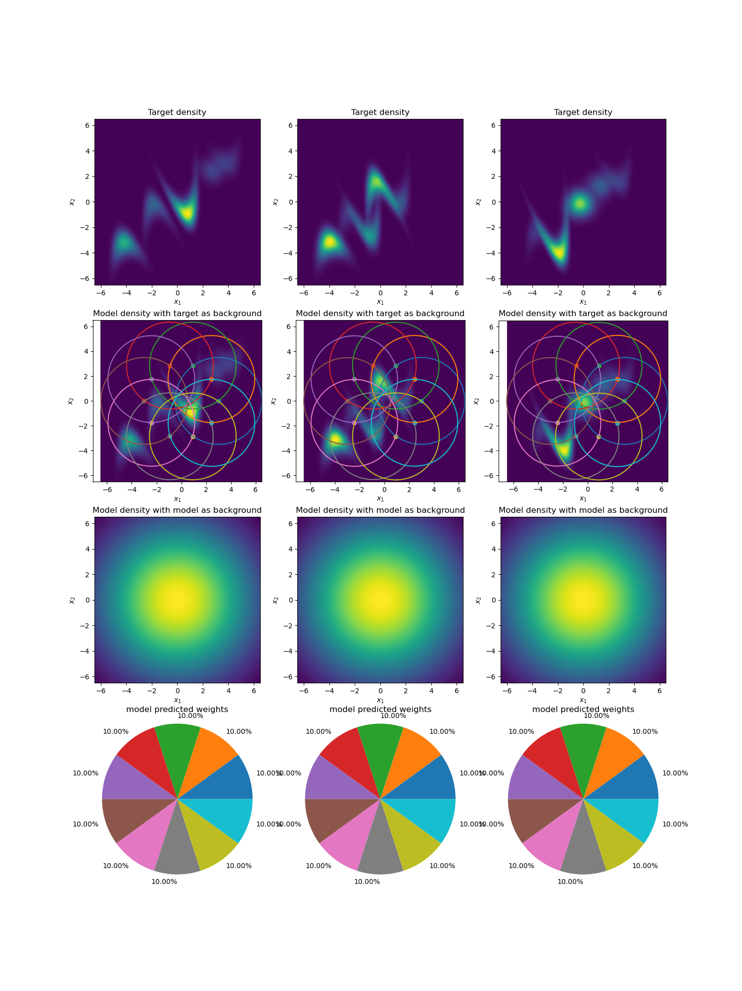
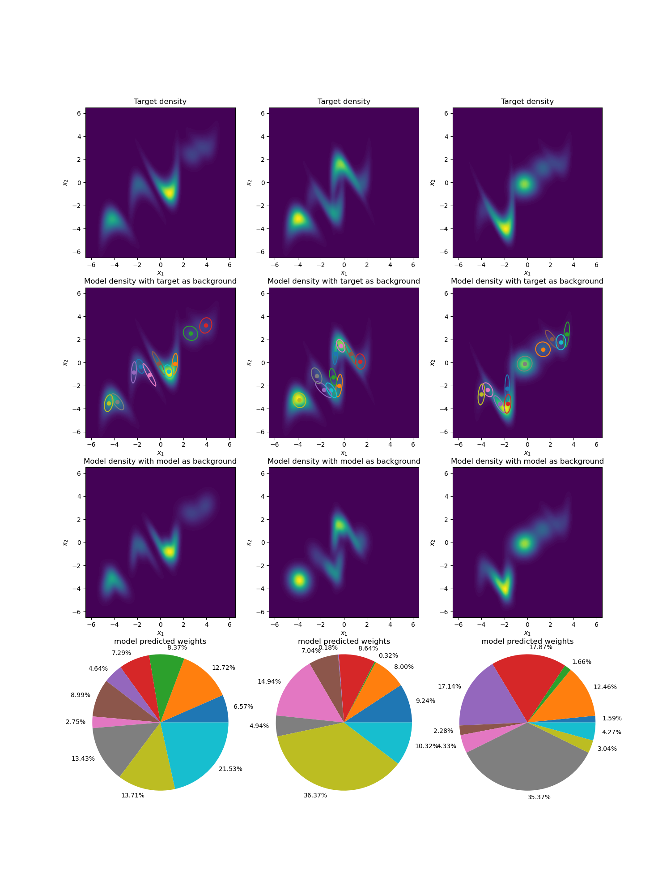
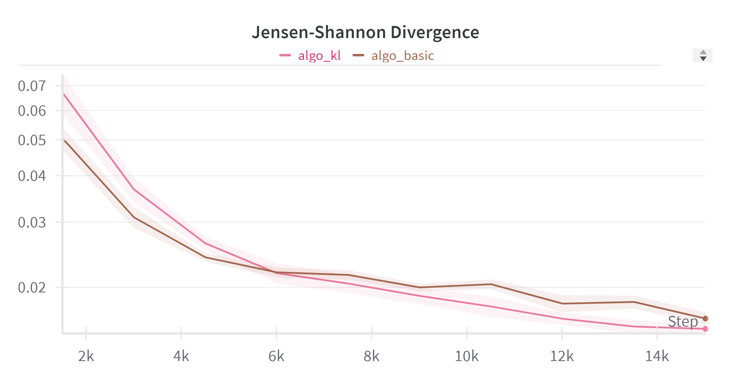
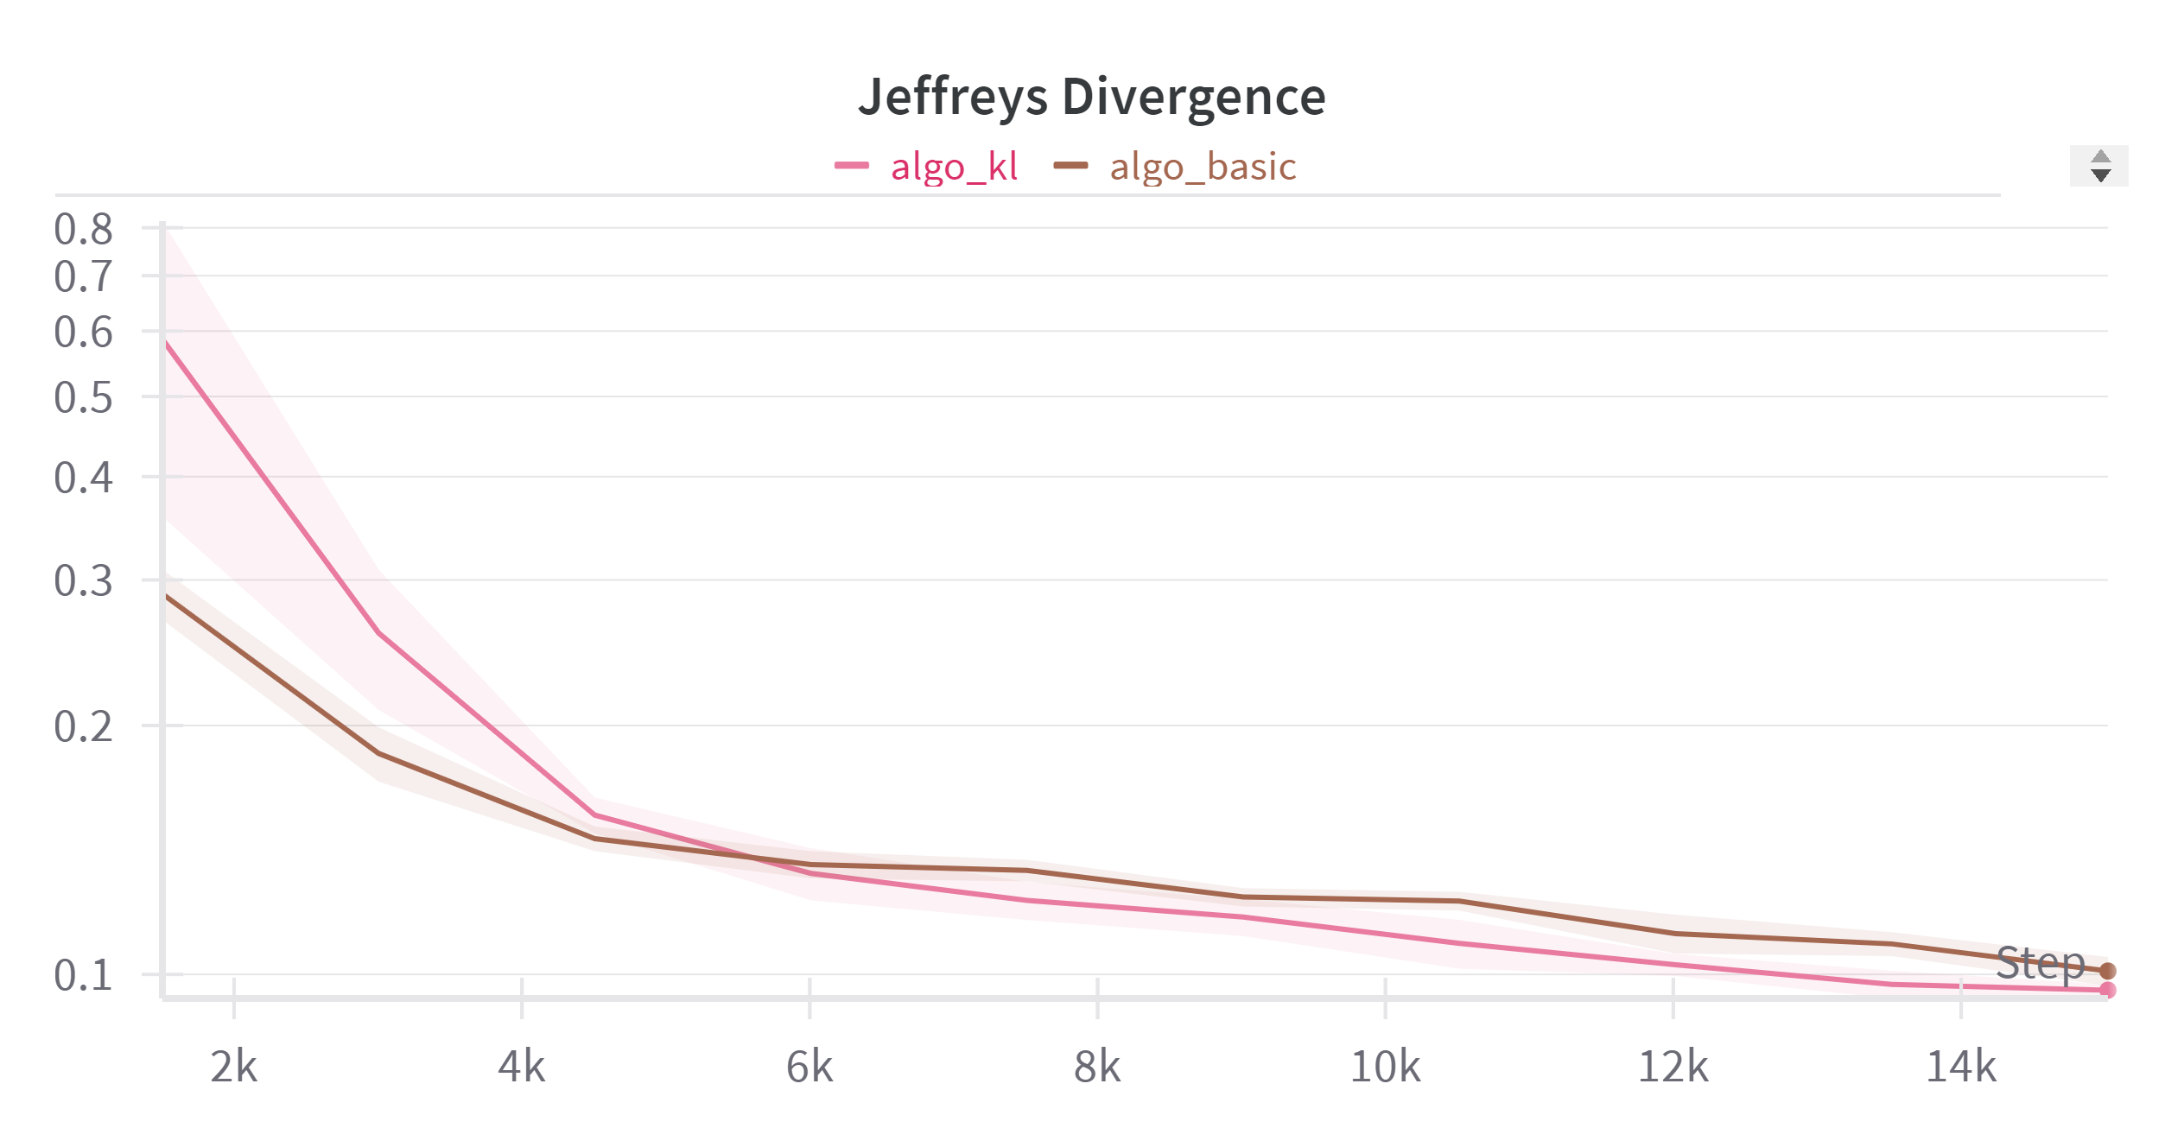
Toy Task-BMM
initial model distribution
learned model distribution
c
9
12/1/2024

Slide 10
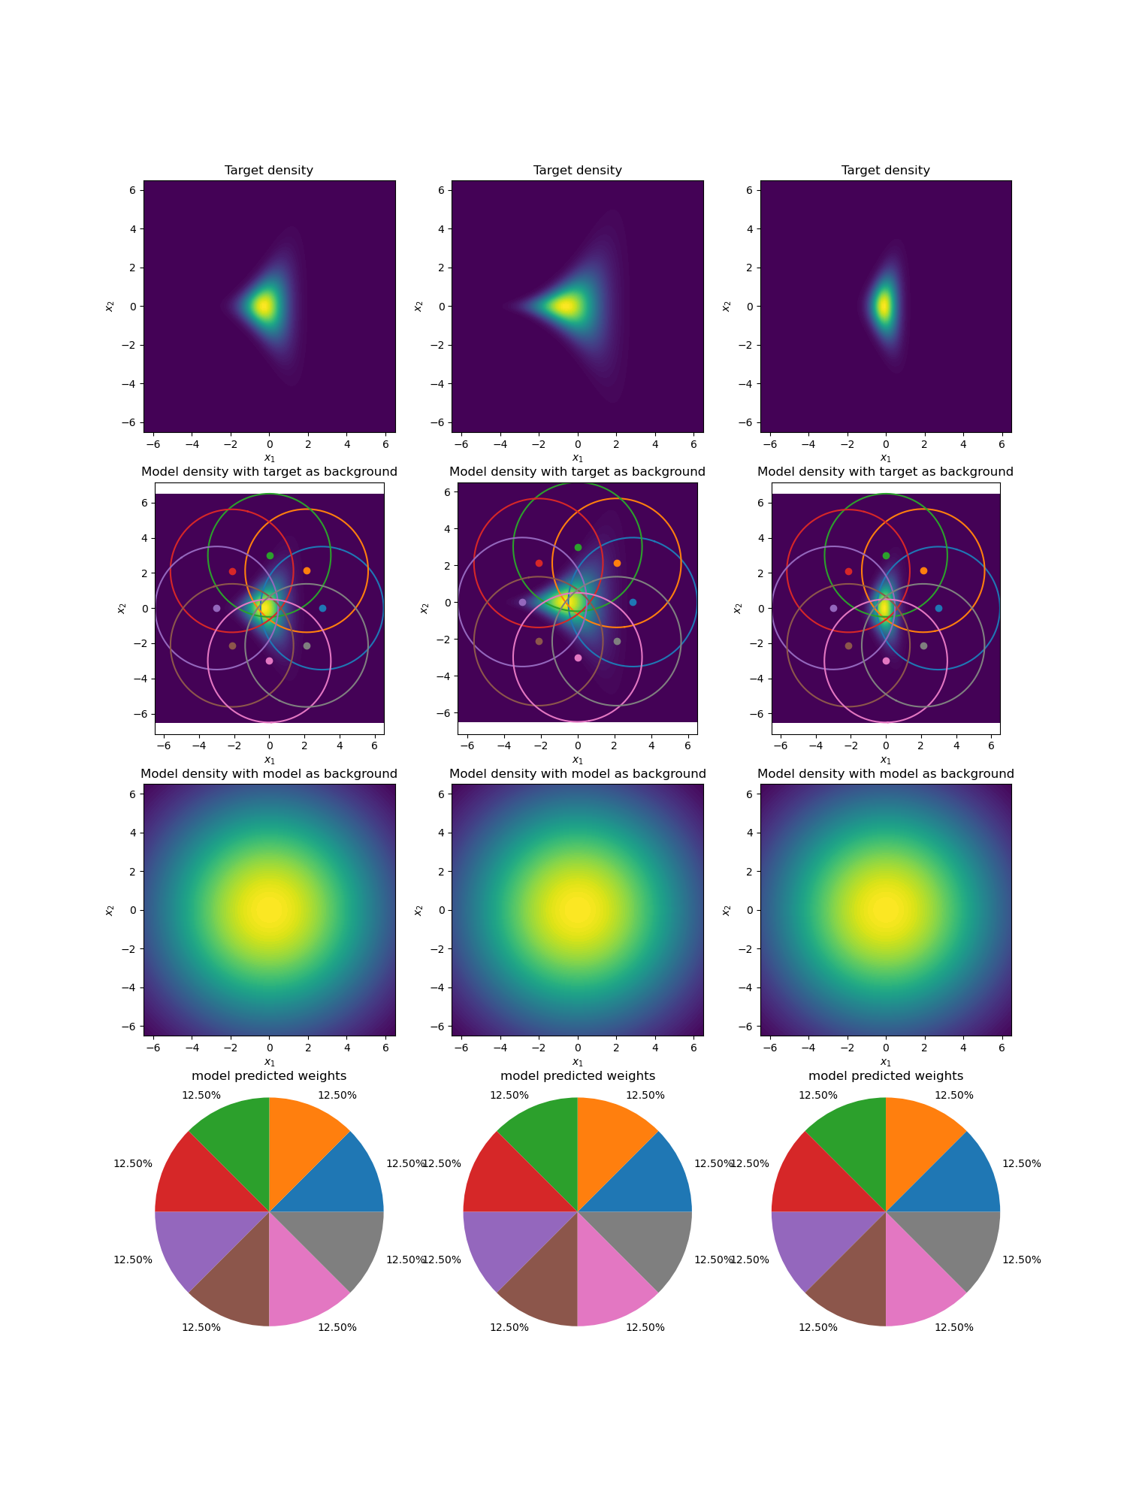
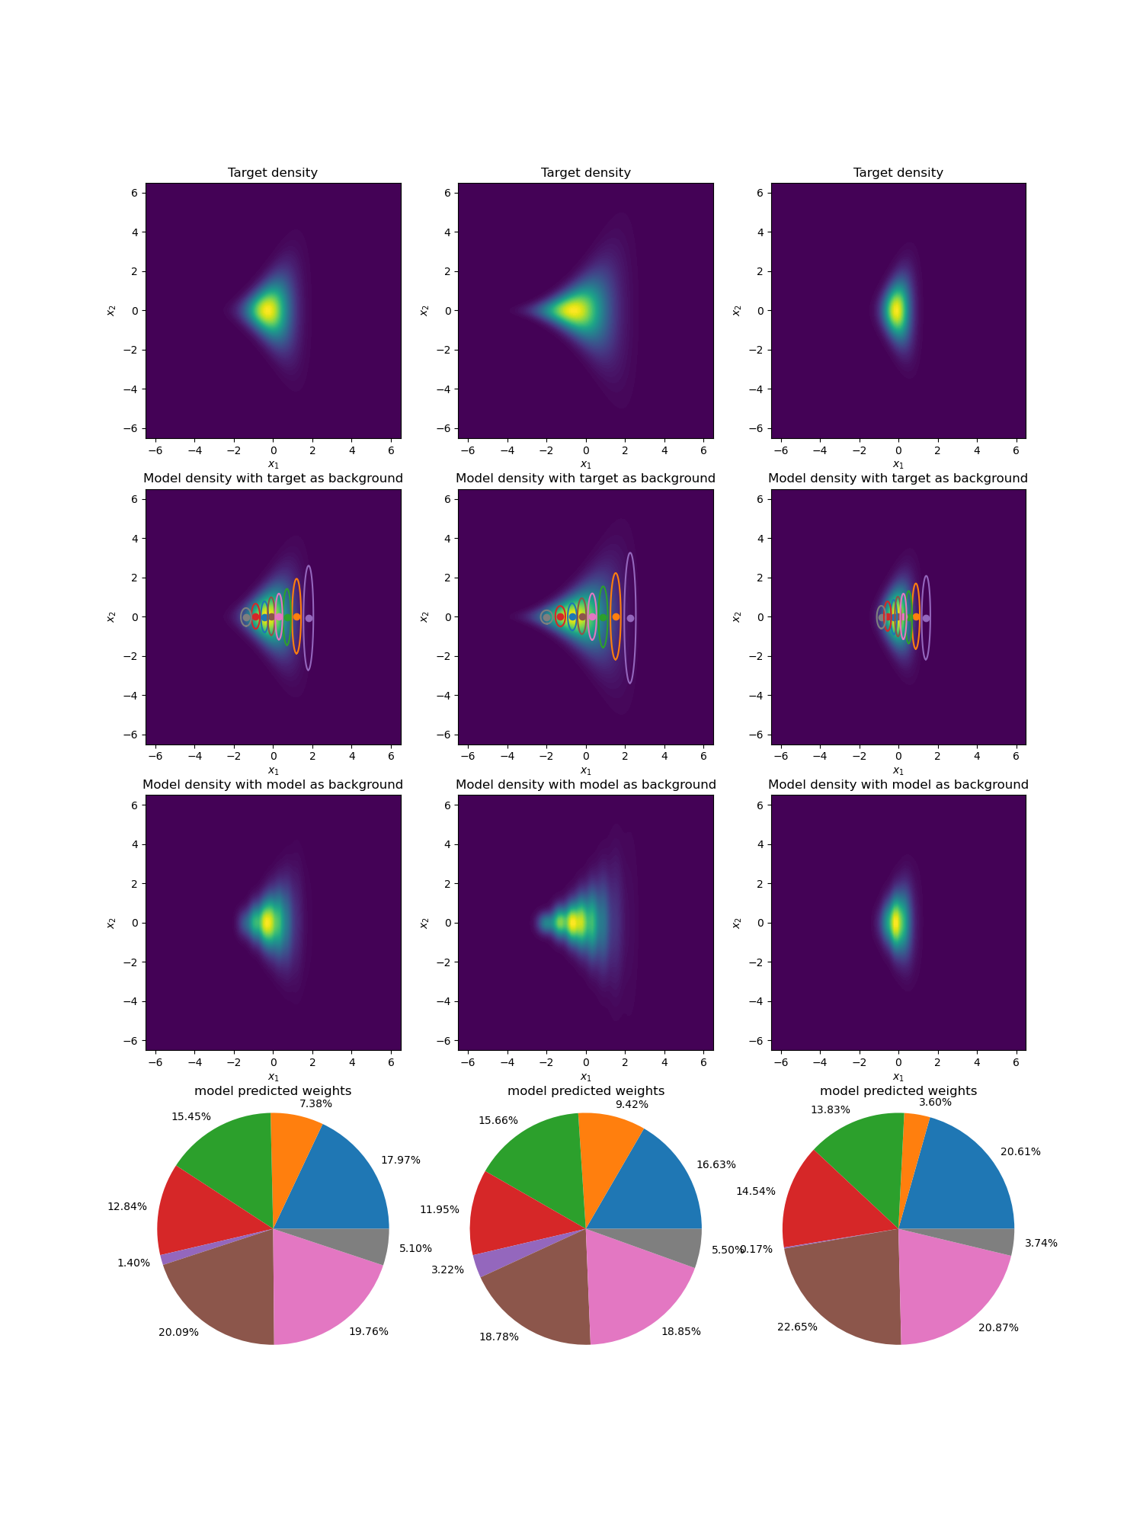
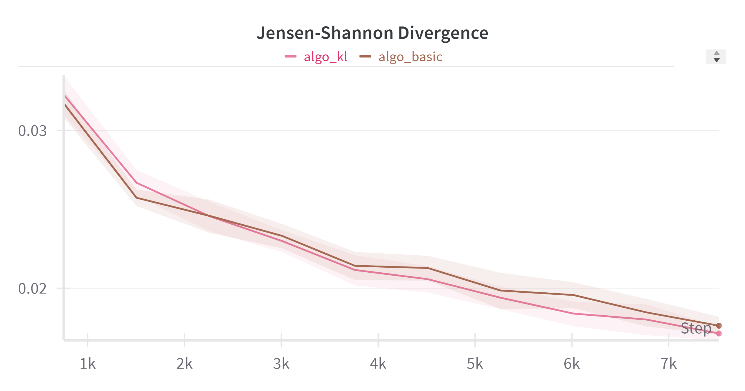
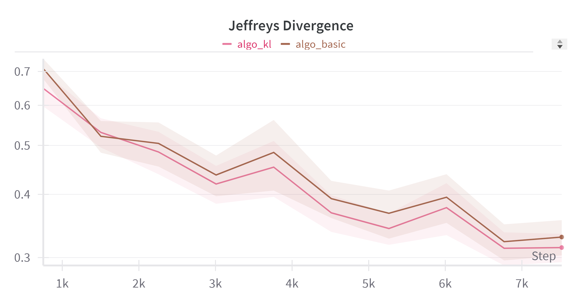
Toy Task-Funnel
initial model distribution
learned model distribution
10
12/1/2024

Slide 11
Next Step
apply trust region method on gating
apply trust region method on algorithm 3
ability to add/remove components
apply VAE in real world task
11
12/1/2024

Slide 12
Thank you for your attention! Questions?
12
12/1/2024

Slide 13
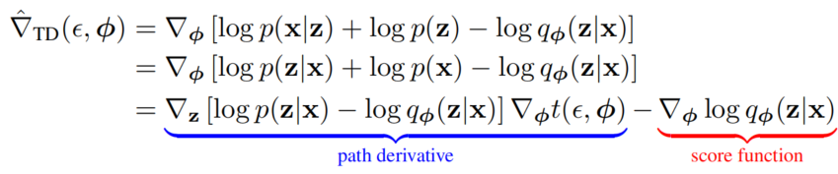
Appendix
Algorithm 3: sticking the landing
take the total derivative of the integrand of the ELBO
score function part causes high variance, but it has expectation zero, so we can remove it.
13
12/1/2024

